Slide 1


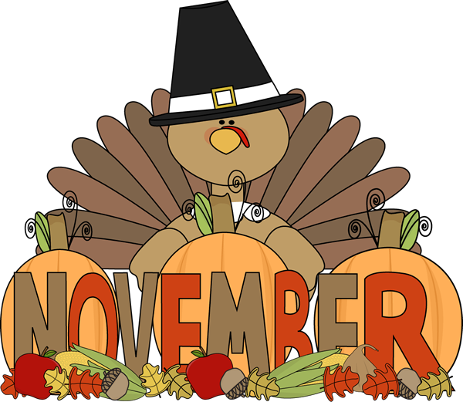


Important Dates:
November 20th- Conferences: 4-8PM
November 21st-
Conferences: 8am-12pm
No School- November
21st-23rd
Learning Targets:
1st Math- Addition and subtraction story problems
1st Reading- Recognize and read known words. Writing: Structure of a sentence
2nd Math- Shapes, blocks, and symmetry
2nd Reading- Building & spelling words.
Writing: Identify nouns, adjectives, and verbs, in a sentence.
November 11th-
Veteran’s Day
Please reach out with any questions or concerns.
-Mrs. Padilla
This Photo by Unknown Author is licensed under CC BY-NC

